Slide 1
Decentralized Traceability And Direct Marketing Of Agriculture Supply Chains With QR Scanner

Slide 2
INDEX
Abstract
Objective of project
Problem Statement
Scope & Motivation
Introduction
Literature survey
Literature survey for second objective
Existing Method
Disadvantages
Proposed method
Advantages
Project Flow
Hardware and Software Requirements
Architecture
Modules
UML Diagram
References

Slide 3
ABSTRACT
The decentralized traceability and direct marketing platform for agriculture supply chains. Globalized delivery of manufacturing and agricultural production offer renewed attention to the health, efficiency, and validation of many vital criteria in the food and agricultural supply chain. That numbers of food safety and corruption hazards have generated an enormous need of an efficient traceability solutions which acts as an essential quality managements tools ensuring to enough product’s safety within the agriculture supply chain. Block chain is the revolutionary technological method, which provides the ground breaking result for commodity traceableness in agriculture and in food supply chains. Today's agricultural supplying chains are complicated ecosystems mixing several stakeholders making it difficult to validate several significant requirements mainly towards nation of first origin, crop growth phases, quality standards compliance, and yield monitoring. This paper proposes a strategy that levitates the block chain and conducts business operations effectively across the agricultural supply chain for tracking crop prices and traceability.

Slide 4
ABSTRACT
The proposed framework solution discards the need for trusted centralized authority, intermediaries and offers records of the transactions, improving efficient science and safety with high integrity and reliability. All transactions are registered and then stored in block chain’s unchangeable ledger with linkages to a decentralized le network, thereby ensuring vary high degree of traceability and transparency in the supply chain ecosystem in a stable, reliable and in efficient manner.
Keywords: Decentralized, Traceability, Direct marketing, Agriculture, Supply chains, QR scanner.

Slide 5
OBJECTIVE OF PROJECT
The project aims to revolutionize the agricultural supply chain by integrating blockchain technology, enhancing traceability and transparency. This decentralized platform addresses food safety and corruption concerns, ensuring product safety and quality standard compliance. By eliminating the need for centralized authorities and intermediaries, the strategy offers an immutable record of transactions, bolstering efficiency, security, and trustworthiness. It streamlines the complex supply chain ecosystem, ensuring accurate tracking of crop prices, origin, growth stages, and yield monitoring, fostering a reliable and efficient system.

Slide 6
PROBLEM STATEMENT
The globalized nature of agricultural production and manufacturing has intensified concerns regarding food safety, efficiency, and validation within supply chains. The rising incidents of food safety breaches and corruption highlight the dire need for efficient traceability solutions as vital quality management tools. Contemporary agricultural supply chains are intricate, involving multiple stakeholders, making verification of origin, growth phases, and compliance challenging. Existing systems, reliant on centralized authorities and intermediaries, lack transparency and integrity. There's a pressing demand for a decentralized, reliable solution to ensure transparency, traceability, and efficiency in agricultural supply chains.

Slide 7
SCOPE AND MOTIVATION
The project aims to revolutionize agricultural supply chains using blockchain technology. By decentralizing traceability and eliminating the need for intermediaries, it ensures high-quality standards, enhanced product safety, and verifiable origin tracking. The proposal leverages blockchain's immutable ledger, recording all transactions and offering unparalleled transparency and reliability. This approach simplifies complex supply ecosystems, making crop price tracking, compliance, and yield monitoring more efficient, ultimately fostering a trustworthy, transparent, and streamlined supply chain environment.

Slide 8
INTRODUCTION
To ensure product safety, handling the growth of farming products and effective management of logistics -chain in agricultural supply chain is censorious. That cover about food safety and the risk of contamination has renewed the prominence of tracing power across the supply chain Moreover, farming goods exchanged across multiple nations require accurate tracking and compliance with nation-specific regulations Tracing of goods in the agricultural field requires to gather, communicate and maintain critical data by specifically identifying the source, multiple data exchanges in the logistic network. High-spirited nature of data in the agricultural / food supply chain where products are manufactured, processed and sent through multiple intermediaries allows tracking and tracing difficult. Contamination of products and its public health consequences highlight traceability as the required policy instrument for tracking food quality and safety. The present traceability practice in the supply chain of agriculture is mainly affected by data fragmentation and centralized controls that are susceptible to both information modification and management.

Slide 9
INTRODUCTION
Improving food safety, and providing a means to verify food quality attribute are driving the development of traceability initiatives in agri-food system. The United Nation Food and Agriculture Organization (FAO) and the International Telecommunications Union (ITU) are continuing to work together to facilitate the use of innovation Information and communication technologies (ICTs) in agriculture. The importance of traceability has significantly increased with the globalization of the food industries. Therefore, the need for a reliable identification and tracking system is necessary to ensure the quality and safety of food which reaches the consumer. Block chain for Supply Chain is a natural fusion of two technologies, built for mutual or common ledge transactions. A supply chain often reflects a distribution of products through industries, and is also cross-border. Food provenance is one pf FSC’s most difficult issue. This issue companies are facing today. A global supply chain network with asymmetric food regulation and multiple operating procedure between various countries makes end-to-end food tracking incidental to the food industry. Distributed ledger/Block chain is very important technology that can significantly impact the supply chain management. This paper shows the possibility of block chain technology using supply chain for both perishable product and manufacturing. In food supply chain firms are rapidly adopting block chain system. Example for retailers such as Carrefour indicates that block chain can be used to provide access to rich and details information about food product, which is used to reduce the uncertainty about quality and ingredient. Food safety has been an enormous concern in china over the last few years. As conventional agri-food logistic practices can no longer satisfy consumer demands, developing a traceability framework for agri-food supply is becoming increasingly urgent

Slide 10
LITERATURE SURVEY
SNo. | Year | Authors | Title | Key Outcomes / Contributions
1 | 2020 | Kamilaris, A., Fonts, A., Prenafeta-Boldó, F.X. | The rise of blockchain technology in agriculture and food supply chains | Provides a comprehensive review of early blockchain applications in agri-food. Highlights benefits like enhanced transparency, fraud prevention, and improved food safety. Identifies challenges of scalability, interoperability, and high energy consumption for some consensus mechanisms.
2 | 2019 | Tian, F. | An agri-food supply chain traceability system for China based on RFID & blockchain technology | Proposes a framework integrating RFID and blockchain. Demonstrates how immutable records from farm to table can dramatically reduce data tampering and improve recall efficiency. Emphasizes the system's ability to verify origin and quality compliance.
3 | 2021 | Yadav, V.S., Singh, A.R., Raut, R.D., & Govindarajan, U.H. | Blockchain technology adoption barriers in the Indian agricultural supply chain | Investigates practical implementation challenges. Key barriers include technological complexity, lack of infrastructure, high initial costs, and resistance from intermediaries. This study contextualizes the "discarding of intermediaries" mentioned in your abstract as a significant hurdle.
4 | 2022 | Mondal, S., Wijewardena, K.P., Karuppuswami, S., et al. | Blockchain inspired RFID-based authentication architecture for food supply chain | Focuses on the integration of physical (RFID/QR) and digital (blockchain) tracking. Proposes a secure architecture where IoT sensor data is hashed onto the blockchain, and a QR/RFID tag provides the key for consumers to access immutable product history, linking directly to your platform's proposed user interface.

Slide 11
LITERATURE SURVEY
SNo. | Year | Authors | Title | Key Outcomes / Contributions
5 | 2018 | Salah, K., Nizamuddin, N., Jayaraman, R., & Omar, M. | Blockchain-Based Soybean Traceability in Agricultural Supply Chain | Presents a concrete case study for soybean tracking. Shows how blockchain can log critical data (origin, batch, processing, shipping) in a tamper-proof ledger, enabling all stakeholders to trace the product's journey and validate claims about growth phases and quality.
6 | 2023 | Gupta, R., Srivastava, A., & Singh, S.K. | Decentralized Direct-to-Consumer Models in Agri-Food Using Blockchain and Smart Contracts | Directly addresses your "direct marketing" component. Explores how blockchain platforms can connect farmers directly with consumers, using smart contracts to automate payments and logistics. Highlights economic benefits for farmers and trust benefits for consumers.
7 | 2021 | Kumar, R., & Tripathi, R. | Traceability of Tamarind in Food Supply Chain Using Blockchain and IoT | Another specific crop study. Combines IoT sensors (for soil, climate data) with blockchain to create a rich, verifiable digital footprint for a product. Outcomes show enhanced transparency in crop growth phases and yield monitoring, a key criterion from your abstract.
8 | 2024 | Zhao, G., Liu, S., Lopez, C., et al. | A Privacy-Preserving Blockchain Mechanism for Cross-Border Agri-Food Supply Chains | Addresses challenges in globalized delivery. Proposes a blockchain mechanism that ensures data integrity and traceability while protecting business-sensitive information (e.g., exact supplier prices) from unauthorized access, ensuring stable and reliable information sharing across borders.

Slide 12
EXISTING METHOD
There is no computerized system in place to trace the cost of agriculture. Agricultural products cannot be obtained by the farmer.72 percent of the population in India is dependent on the farming industry. Farmers get enormous quantities of crop manufacturing, but they have not got the correct price because they can survive the present circumstances. So they are suicide and nothing is done by the government. So we are attempting to fix this issue in the suggested scheme by tracing the cost of the agricultural product from farmer to client

Slide 13
DISADVANTAGES
Complexity in Implementation: Setting up decentralized systems can be intricate, demanding expertise and resources, making it challenging for smaller agricultural players.
Interoperability Issues: Ensuring compatibility among various decentralized platforms and technologies can be a hurdle, potentially leading to data silos and inefficiencies.
Scalability Constraints: Expanding a decentralized system to accommodate a growing number of users and transactions can be challenging, causing performance issues.
Security Risks: Decentralized systems are not immune to security threats like smart contract vulnerabilities and hacking, posing risks to data integrity and user trust.

Slide 14
PROPOSED METHOD
In proposed system we are using a Block chain helps which helps in maintaining the integrity and transparency of the whole process right from inception of crop details. Blockchain helps in managing and tracing the crop information transparent distribution.

Slide 15
ADVANTAGES
Enhanced Transparency: Decentralized traceability allows consumers to track the journey of agricultural products from farm to table, fostering trust.
Reduced Fraud: Direct marketing eliminates intermediaries, reducing the risk of counterfeit goods and fraud in the supply chain.
Fair Pricing: Farmers receive a fair share of profits by selling directly to buyers, avoiding price manipulation by middlemen.
Efficient Logistics: Real-time data improves inventory management and logistics, reducing wastage and optimizing distribution.

Slide 16
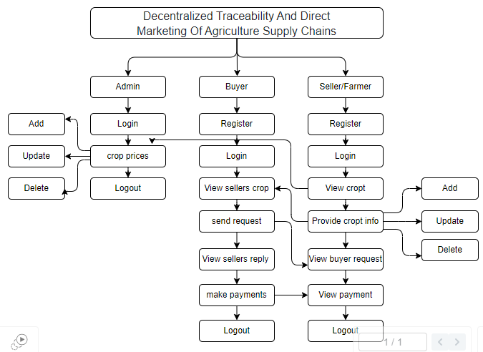
PROJECT FLOW
Figure: Work Flow of Proposed system

Slide 17
HARDWARE & SOFTWARE REQUIREMENTS
H/W CONFIGURATION:
Processor - I3/Intel Processor
Hard Disk - 160GB
Key Board - Standard Windows Keyboard
Mouse - Two or Three Button Mouse
Monitor - SVGA
RAM - 8GB

Slide 18
HARDWARE & SOFTWARE REQUIREMENTS
S/W CONFIGURATION:
Operating System : Windows 7/8/10
Server side Script : HTML, CSS, Bootstrap & JS
Programming Language : Python
Libraries : Flask, Pandas, Mysql.connector, Os, Smtplib, Numpy, web3,truffle, Ganache
IDE/Workbench : PyCharm
Technology : Python 3.6+
Server Deployment : Xampp Server

Slide 19
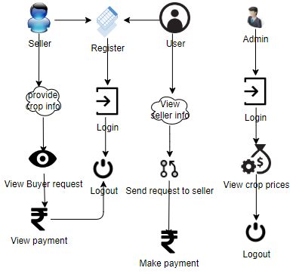
ARCHITECTURE

Slide 20
MODULES
To develop a decentralized traceability for agriculture supply chains, you can break down the functionality into several modules for the different user roles: Buyer, Seller, and Admin. Here are the modules for each role:
Admin:
Login: The admin will login with default email and password.
Crop price: The admin is the person he/ she will add the crop price for each and every crop details with that crop name, category, maximum cost, minimum cost and quantity.
Logout: Allows the admin to log out securely.

Slide 21
MODULES
Buyer:
Register: The buyer will register with their details like name, email, password, address, contact, so after that the buyer will login.
Login: After registration the buyer will login with their details.
View Seller's Crop Information: Once the sellers will add the details the buyer can view those details here.
Send Request to Seller: If the buyer wants the details of crop then buyer will send request to seller.
View Seller Requests: Displays responses from sellers to the buyer's requests.
Make Payment: Once the seller accept the request for the crop the buyer has to pay the amount for that crop.
Logout: Allows buyers to logout securely.

Slide 22
MODULES
Seller:
Register: The seller will register with their details like name, email, password, address, contact, so after that the seller will login.
Login: After registration the seller will login with their details.
Provide Crop Information: The seller will add there crop details like (crop name, crop category, and quantity and quality).
View Buyer Requests: When the buyer will send the request for the crop, here the buyer will view and he/she has to accept the request.
View Payments: Once the buyer will pay the amount for the crops. The seller can view the details of the payment.
Logout: Allows sellers to logout securely.

Slide 23
UML DIAGRAMS
Use Case Diagram:
A use case diagram in the Unified Modeling Language (UML) is a type of behavioral diagram defined by and created from a Use-case analysis. Its purpose is to present a graphical overview of the functionality provided by a system in terms of actors, their goals (represented as use cases), and any dependencies between those use cases. The main purpose of a use case diagram is to show what system functions are performed for which actor. Roles of the actors in the system can be depicted.

Slide 24
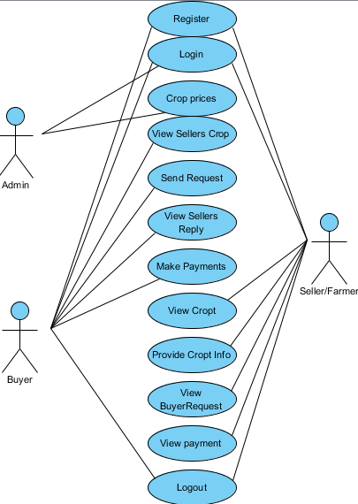
UML DIAGRAMS
Figure: Use Case Diagram

Slide 25
UML DIAGRAMS
Class Diagram:
In software engineering, a class diagram in the Unified Modelling Language (UML) is a type of static structure diagram that describes the structure of a system by showing the system's classes, their attributes, operations (or methods), and the relationships among the classes. It explains which class contains information.

Slide 26
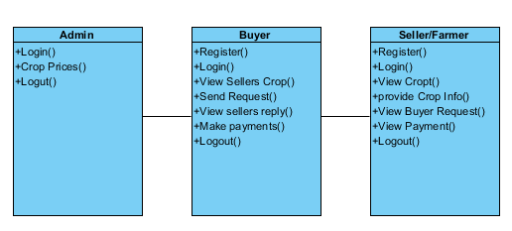
UML DIAGRAMS
Figure: Class diagram

Slide 27
UML DIAGRAMS
Sequence Diagram:
A sequence diagram in Unified Modelling Language (UML) is a kind of interaction diagram that shows how processes operate with one another and in what order. It is a construct of a Message Sequence Chart. Sequence diagrams are sometimes called event diagrams, event scenarios, and timing diagrams.

Slide 28
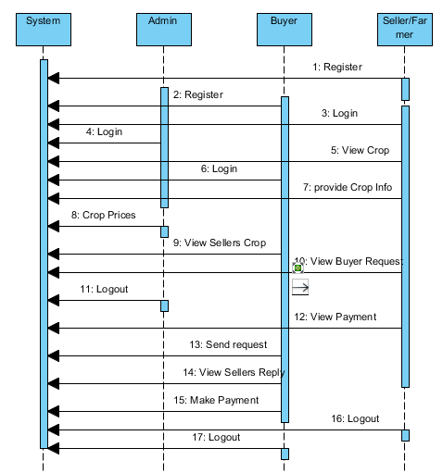
UML DIAGRAMS
Figure: Sequence diagram

Slide 29
UML DIAGRAMS
Collaboration Diagram:
In collaboration diagram the method call sequence is indicated by some numbering technique as shown below. The number indicates how the methods are called one after another. We have taken the same order management system to describe the collaboration diagram. The method calls are similar to that of a sequence diagram. But the difference is that the sequence diagram does not describe the object organization whereas the collaboration diagram shows the object organization.

Slide 30
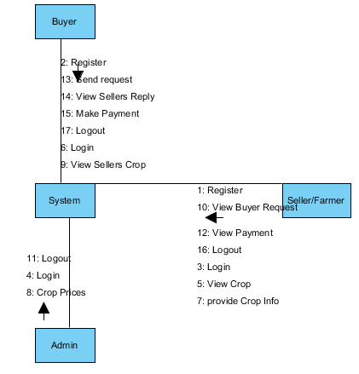
UML DIAGRAMS
Figure: Collaboration diagram

Slide 31
UML DIAGRAMS
Deployment Diagram
Deployment diagram represents the deployment view of a system. It is related to the component diagram. Because the components are deployed using the deployment diagrams. A deployment diagram consists of nodes. Nodes are nothing but physical hardware’s used to deploy the application.

Slide 32
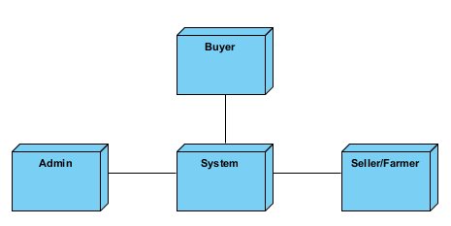
UML DIAGRAMS
Figure: Deployment diagram

Slide 33
UML DIAGRAMS
Activity Diagram:
Activity diagrams are graphical representations of workflows of stepwise activities and actions with support for choice, iteration and concurrency. In the Unified Modelling Language, activity diagrams can be used to describe the business and operational step-by-step workflows of components in a system. An activity diagram shows the overall flow of control.

Slide 34
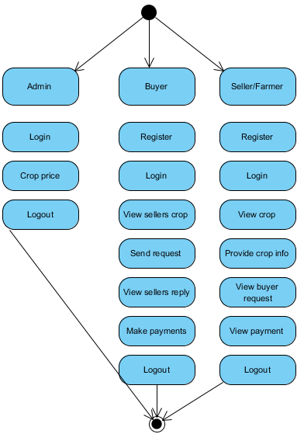
UML DIAGRAMS
Figure: Activity diagram

Slide 35
UML DIAGRAMS
Component Diagram:
A component diagram, also known as a UML component diagram, describes the organization and wiring of the physical components in a system. Component diagrams are often drawn to help model implementation details and double-check that every aspect of the system's required functions is covered by planned development.

Slide 36
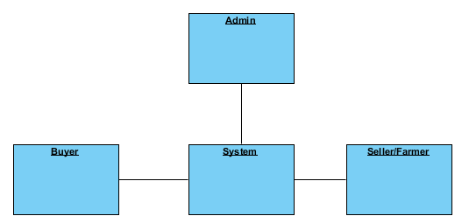
UML DIAGRAMS
Figure: Component diagram

Slide 37
UML DIAGRAMS
ER Diagram:
An Entity–relationship model (ER model) describes the structure of a database with the help of a diagram, which is known as Entity Relationship Diagram (ER Diagram). An ER model is a design or blueprint of a database that can later be implemented as a database. The main components of E-R model are: entity set and relationship set.
An ER diagram shows the relationship among entity sets. An entity set is a group of similar entities and these entities can have attributes. In terms of DBMS, an entity is a table or attribute of a table in database, so by showing relationship among tables and their attributes, ER diagram shows the complete logical structure of a database. Let’s have a look at a simple ER diagram to understand this concept.

Slide 38
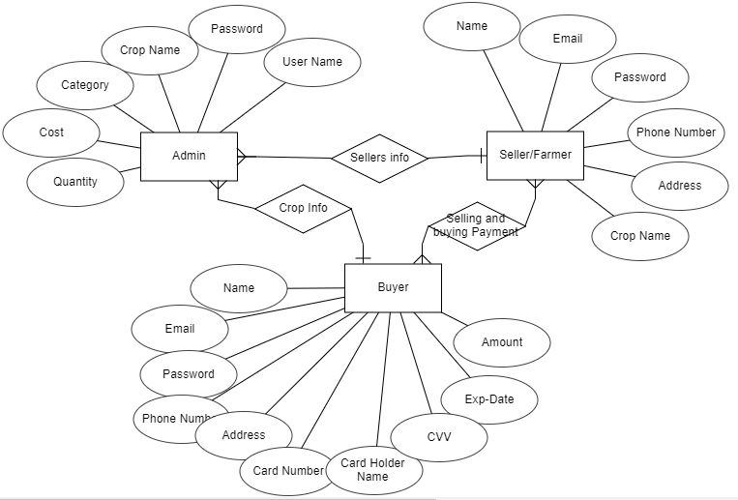
UML DIAGRAMS
Figure: ER diagram

Slide 39
UML DIAGRAMS
DFD Diagram:
A Data Flow Diagram (DFD) is a traditional way to visualize the information flows within a system. A neat and clear DFD can depict a good amount of the system requirements graphically. It can be manual, automated, or a combination of both. It shows how information enters and leaves the system, what changes the information and where information is stored. The purpose of a DFD is to show the scope and boundaries of a system as a whole. It may be used as a communications tool between a systems analyst and any person who plays a part in the system that acts as the starting point for redesigning a system.

Slide 40
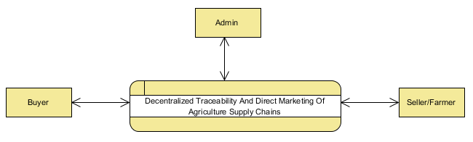
UML DIAGRAMS
Figure: Context Level diagram

Slide 41
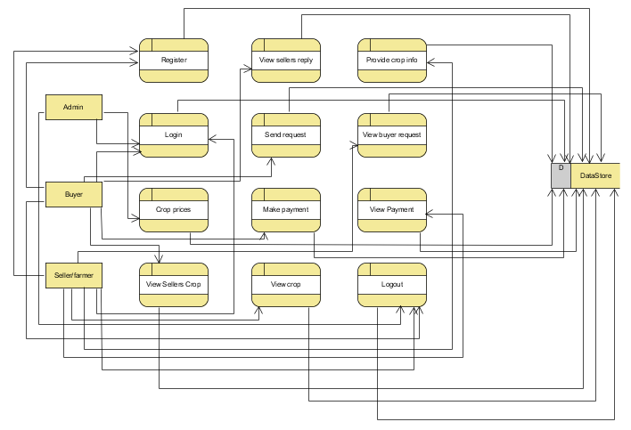
UML DIAGRAMS
Figure: Level-1 diagram

Slide 42
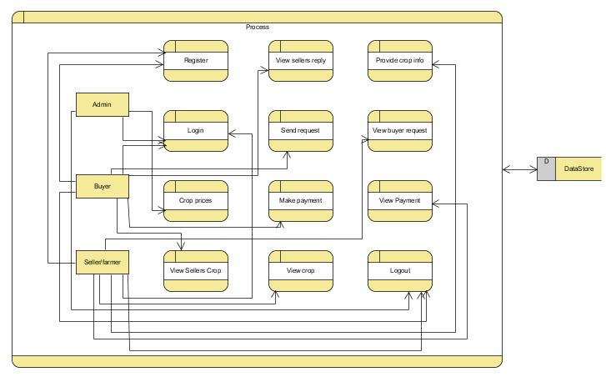
UML DIAGRAMS
Figure:Level-2 diagram

Slide 43
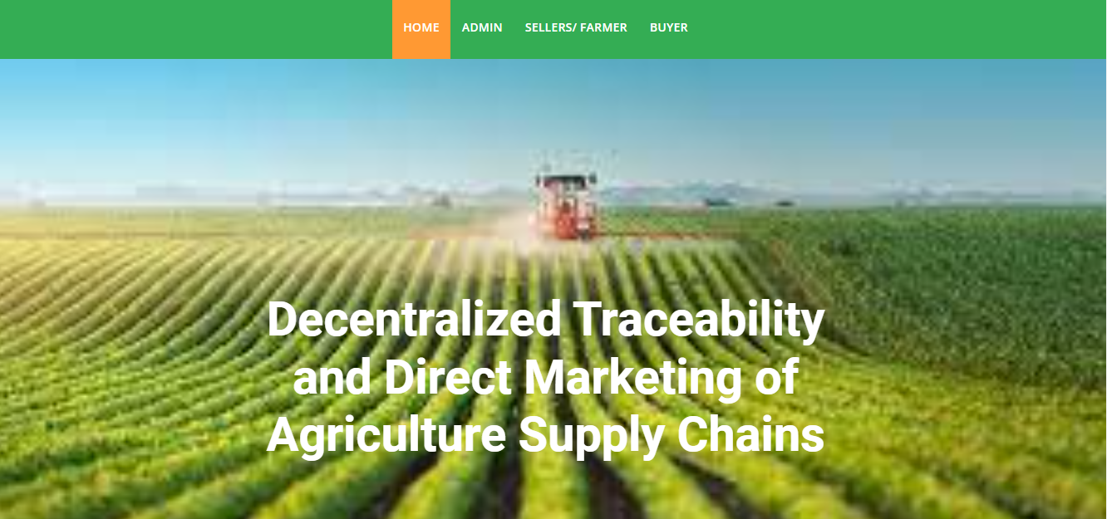
Home Page: Decentralized Traceability and Direct Marketing of Agriculture Supply Chains home page.

Slide 44
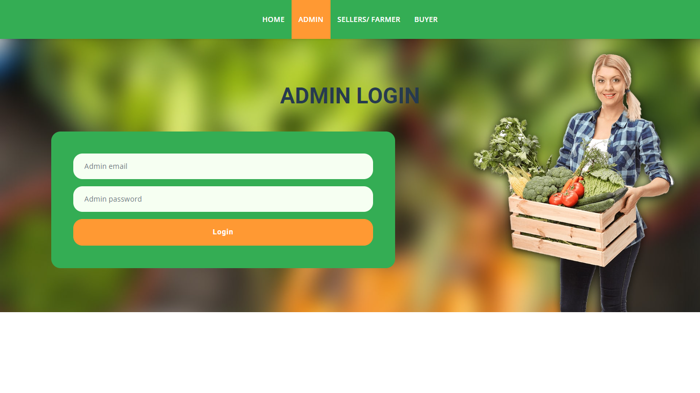
Admin Login page :This is the admin login form, the login can login using their valid credentials.

Slide 45
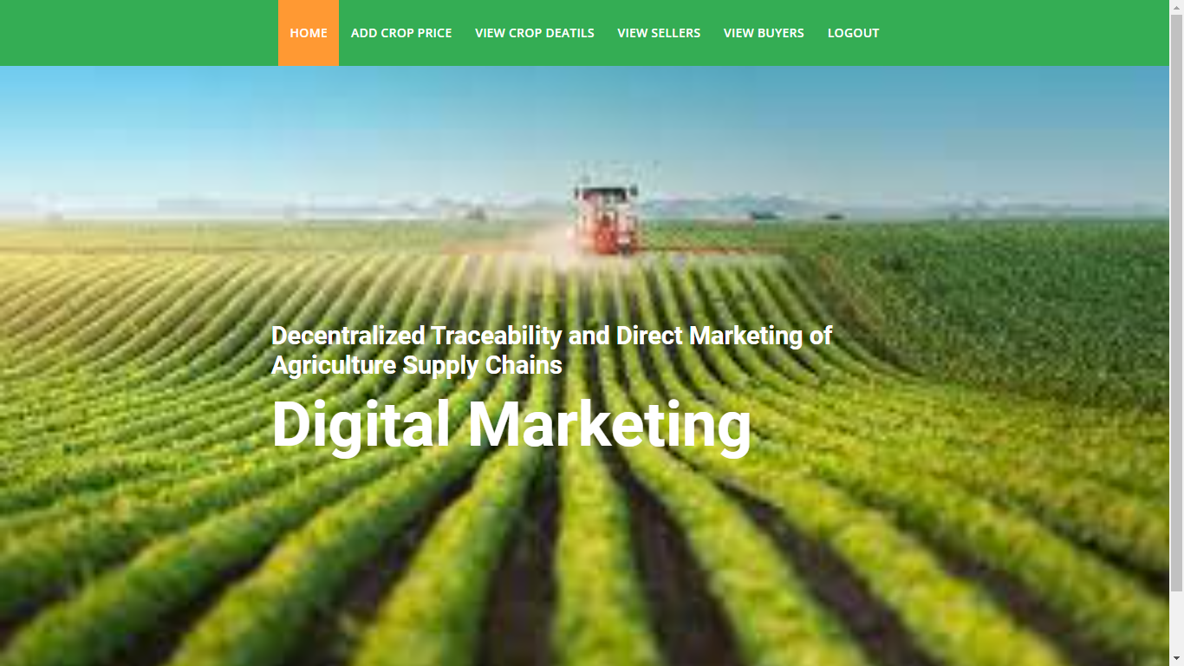
Admin home page: This is the admin home.

Slide 46
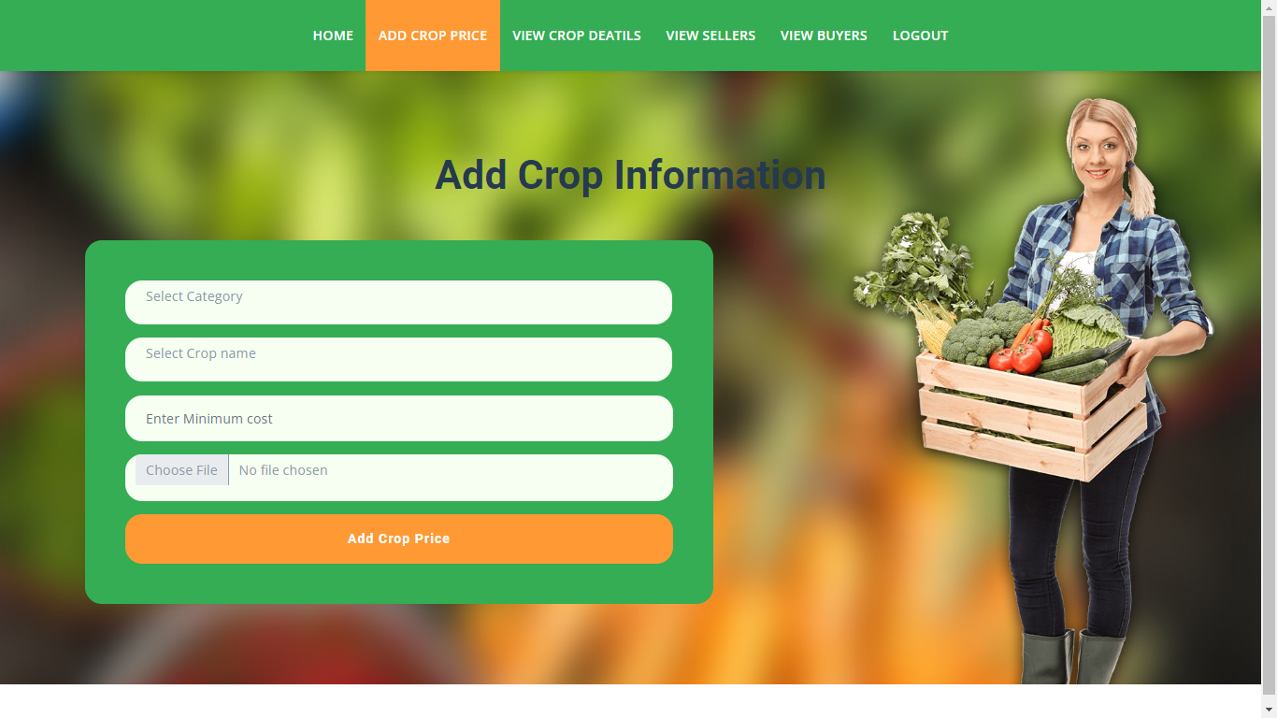
Add crop price : The admin can add the crop details with relevant information

Slide 47
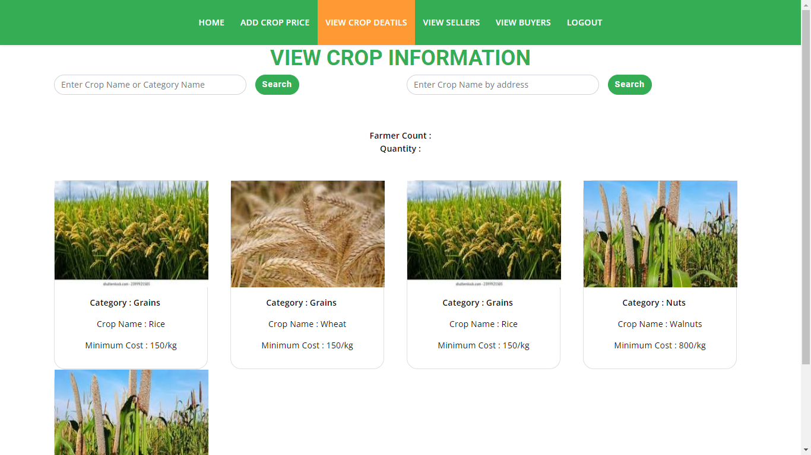
View crop details: Once the sellers/farmers will add the crop details then the admin can view those details

Slide 48

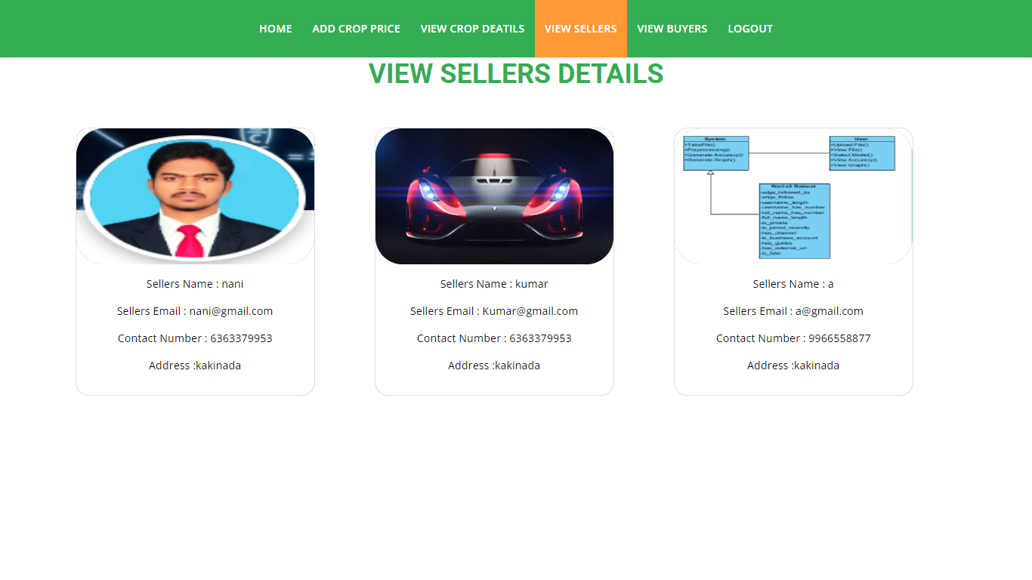
View sellers: Admin can view all the sellers’ details after their registration.

Slide 49
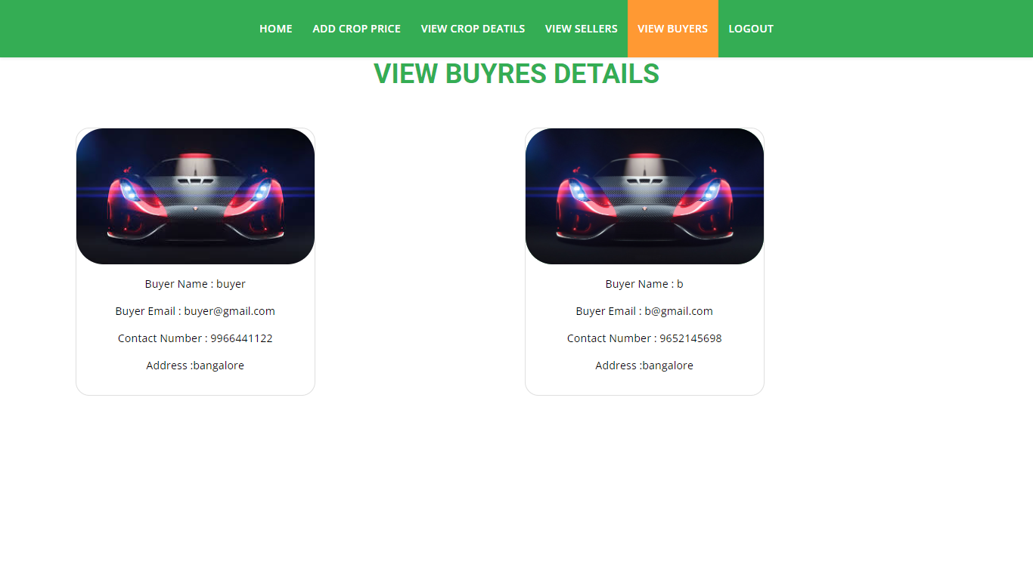
View buyers: Admin can view all the buyers’ details after their registration.

Slide 50
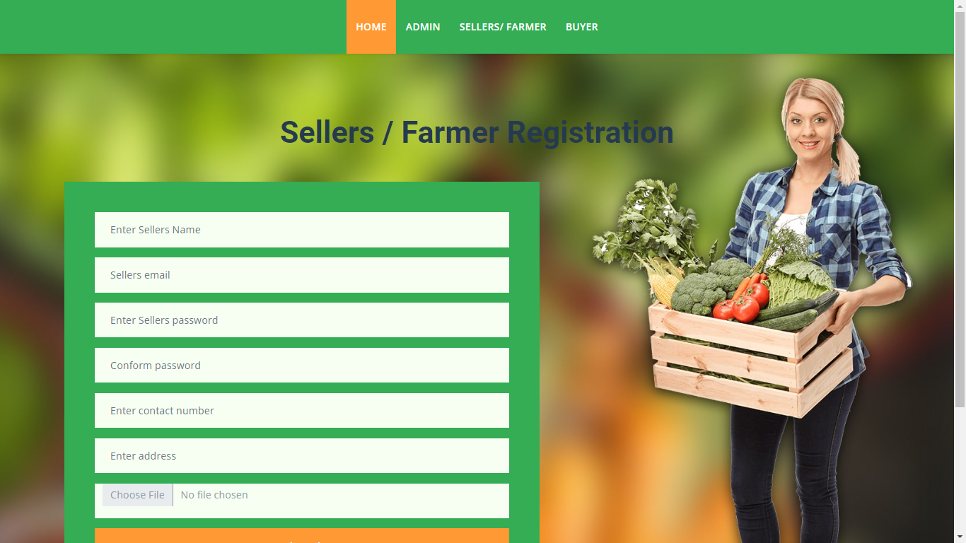
Seller’s registration page: The seller will register with their details like name, email, password, address, contact, so after that the seller will login.

Slide 51
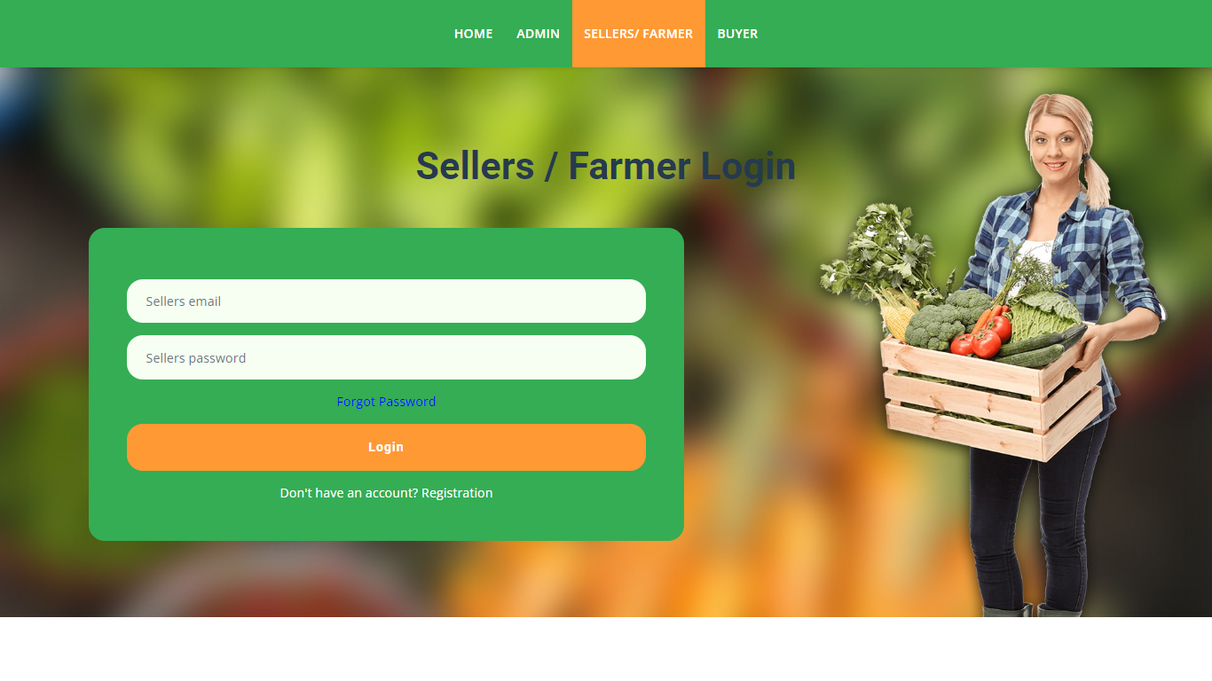
Seller’s login page: After registration the seller will login with their details.

Slide 52
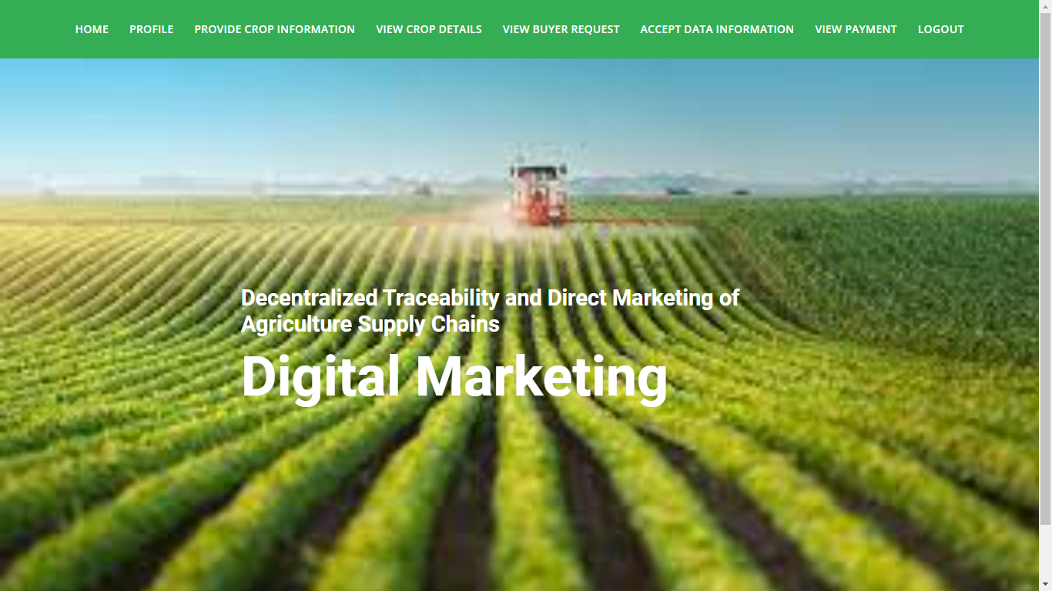
Sellers home page: After Login the will enter into home page.

Slide 53
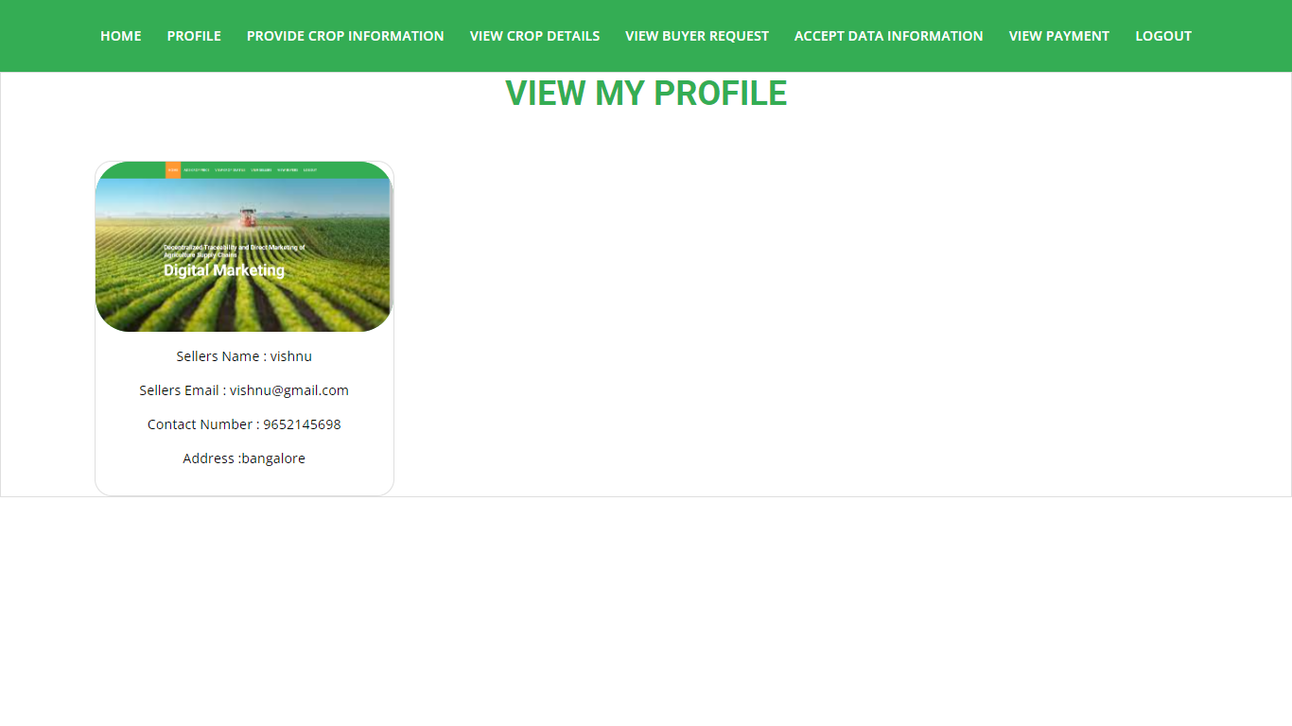
View profile: Here the seller can view the profile.

Slide 54
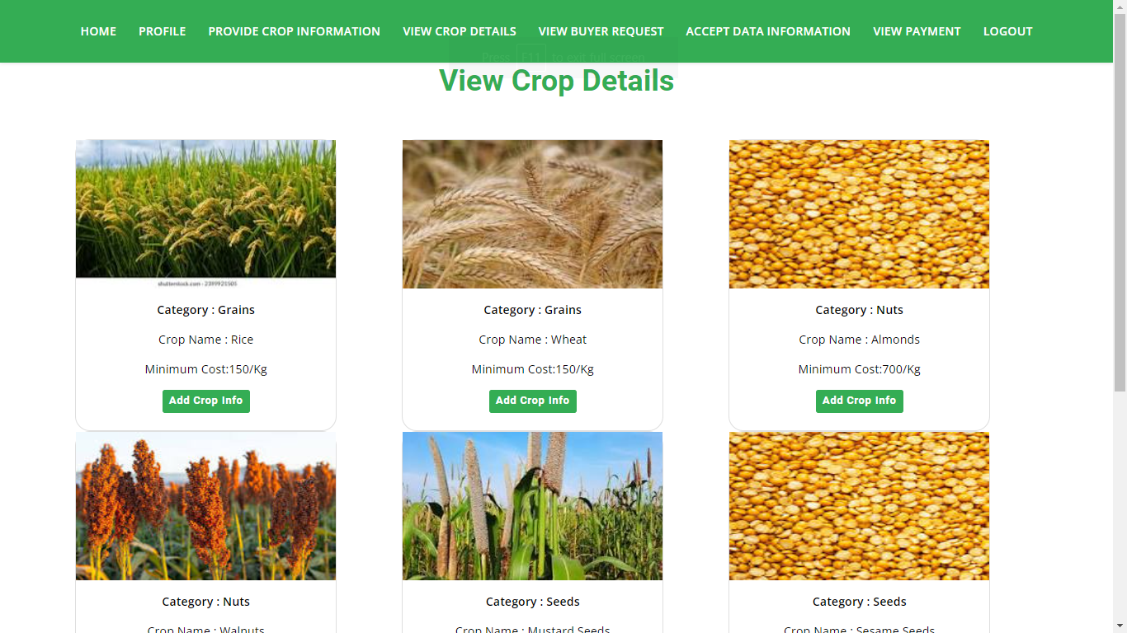
View crop details: Sellers will view the details of the crop and they need to update details.

Slide 55
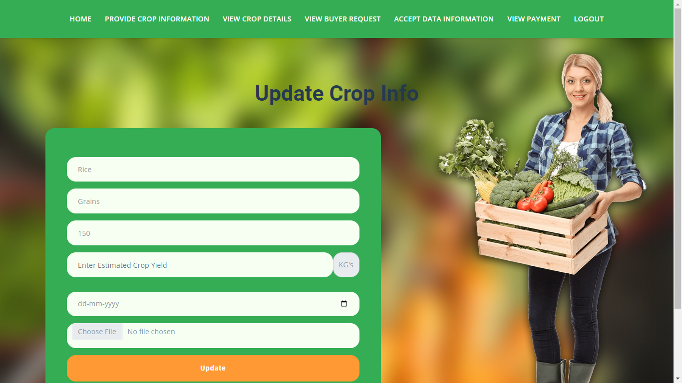
Update crop details: Here the sellers are going to add how much quantity of crop they will grow and when yield will come.

Slide 56
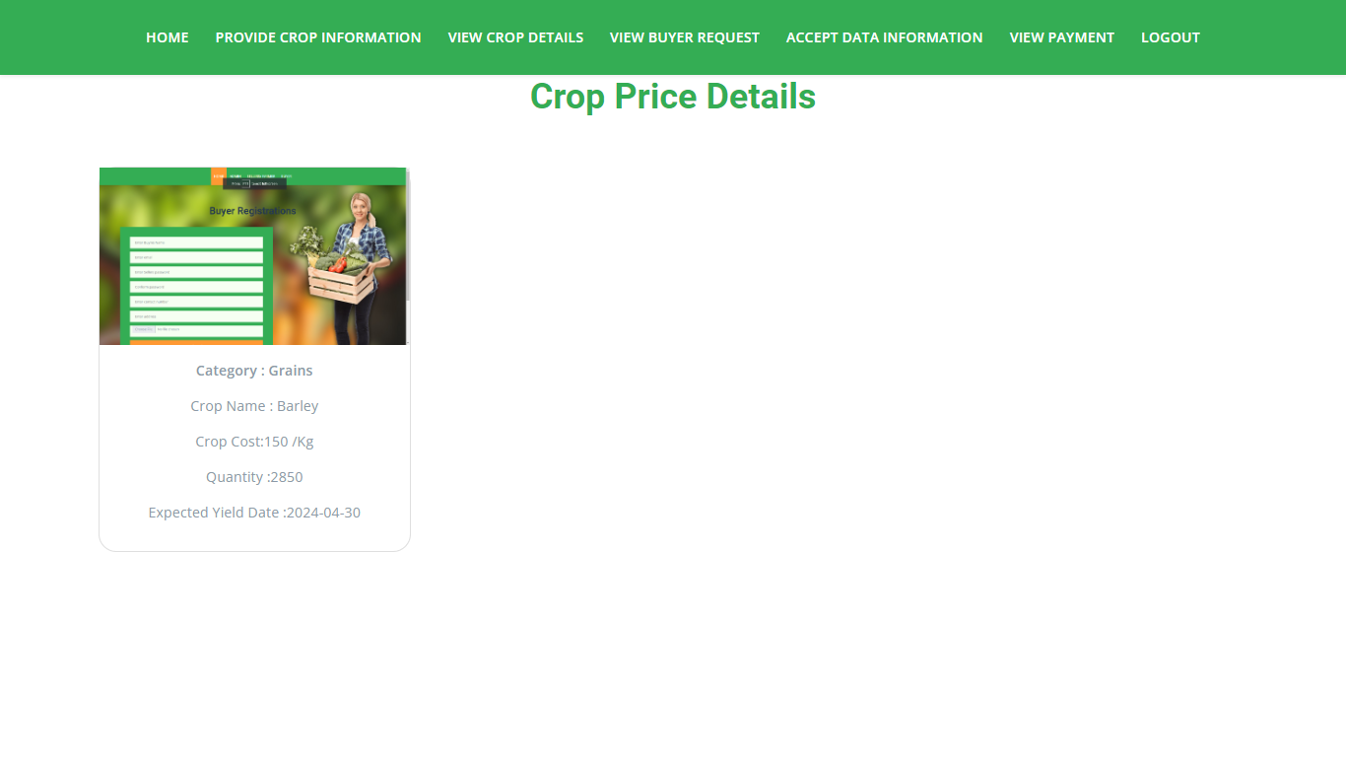
View crop price details: After adding details we can see here with QR code.

Slide 57
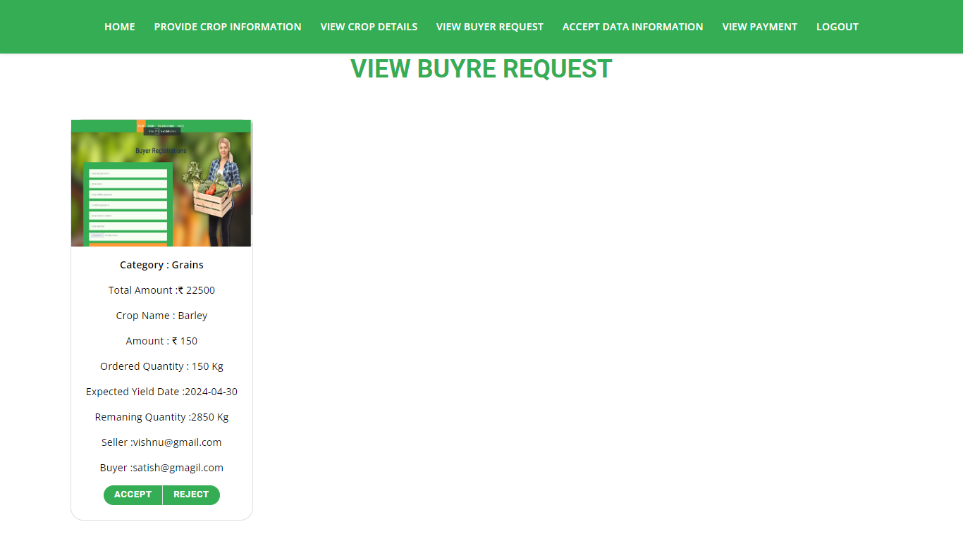
View buyer request: When buyer will request for the crop here sellers need to accept or reject for their crop

Slide 58
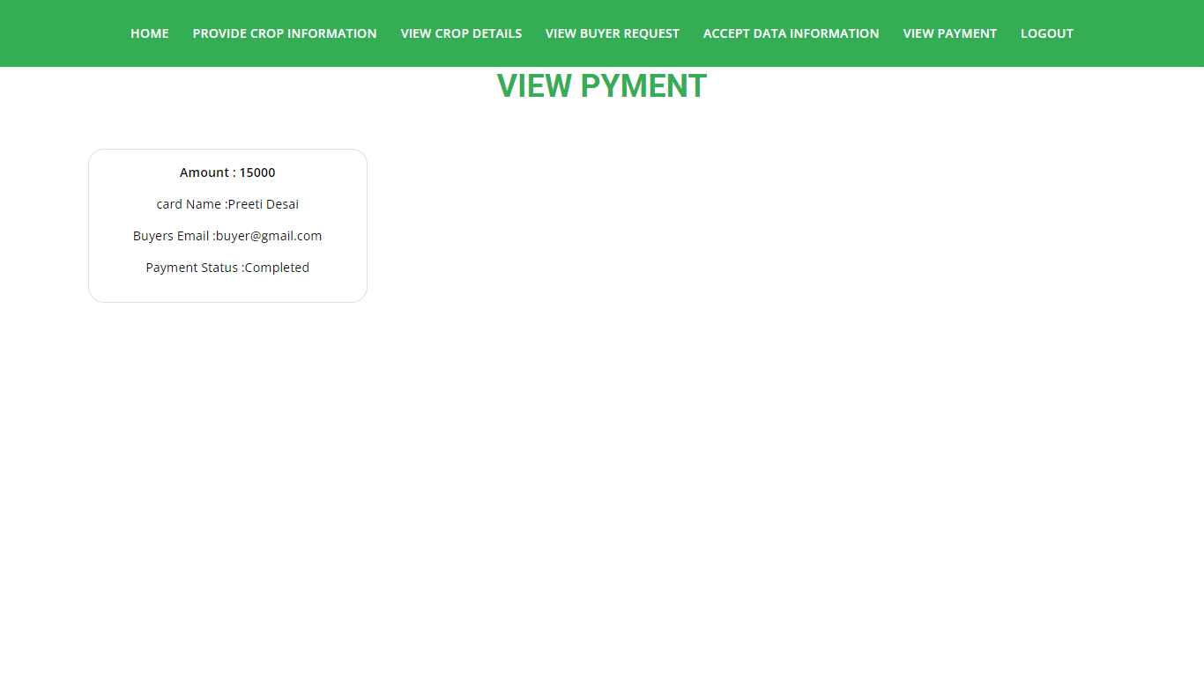
View payment: When the buyer will pay the amount for the crop the sellers will view the data.

Slide 59
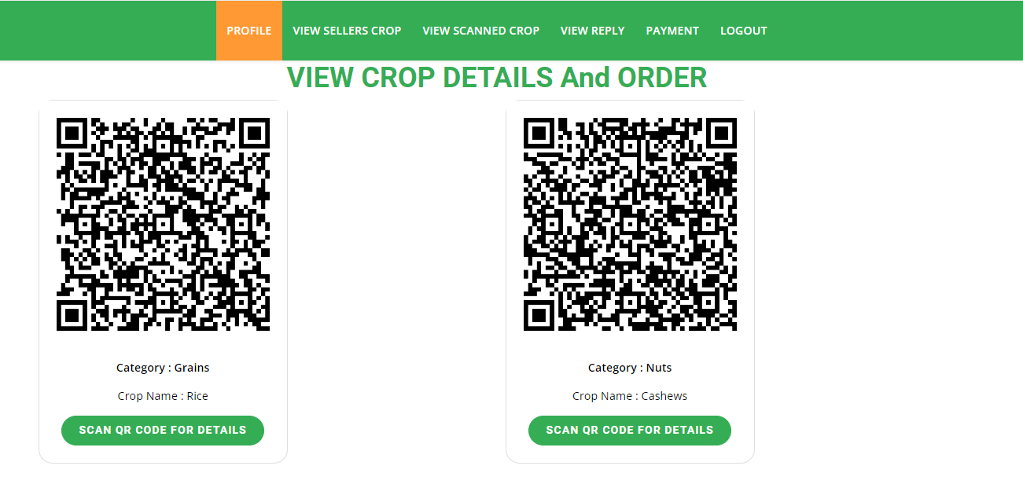
View crop details: Here the buyer can only view the QR code for the crop when they will scan and they can buy

Slide 60
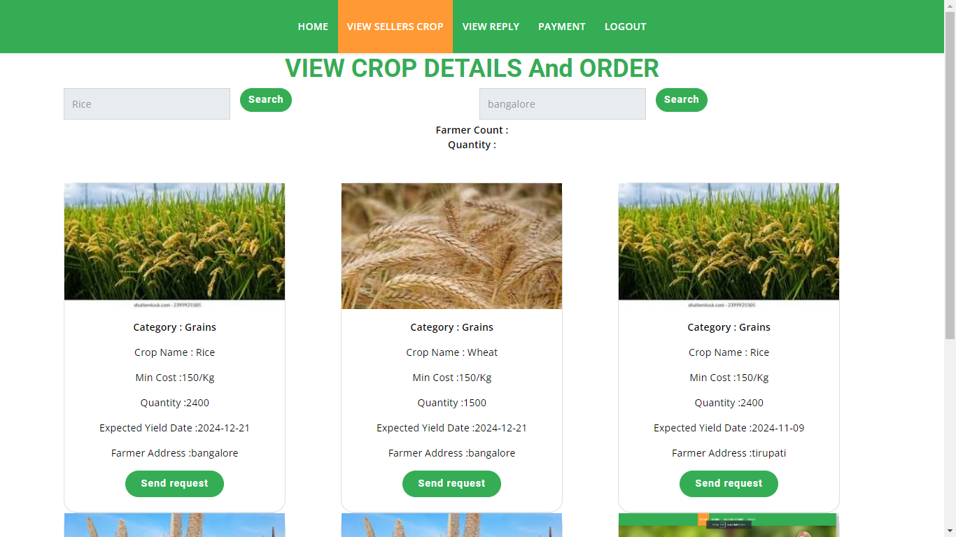
View Scanned Crop Details: After scan only the buyers can view this details and they need to send request for the crop how much he/she need of particular crop.

Slide 61
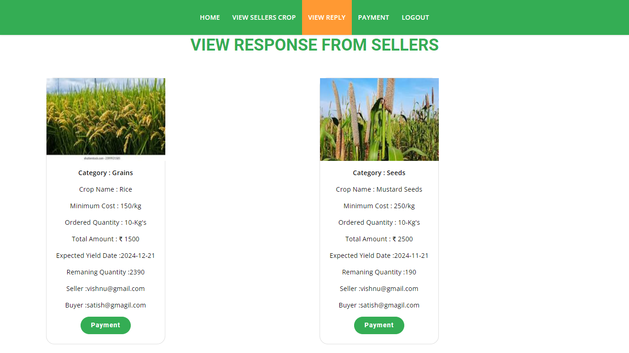
View reply: Here the buyers can view the response for the sellers. After accepting they need to pay the amount after scanning the QR code

Slide 62
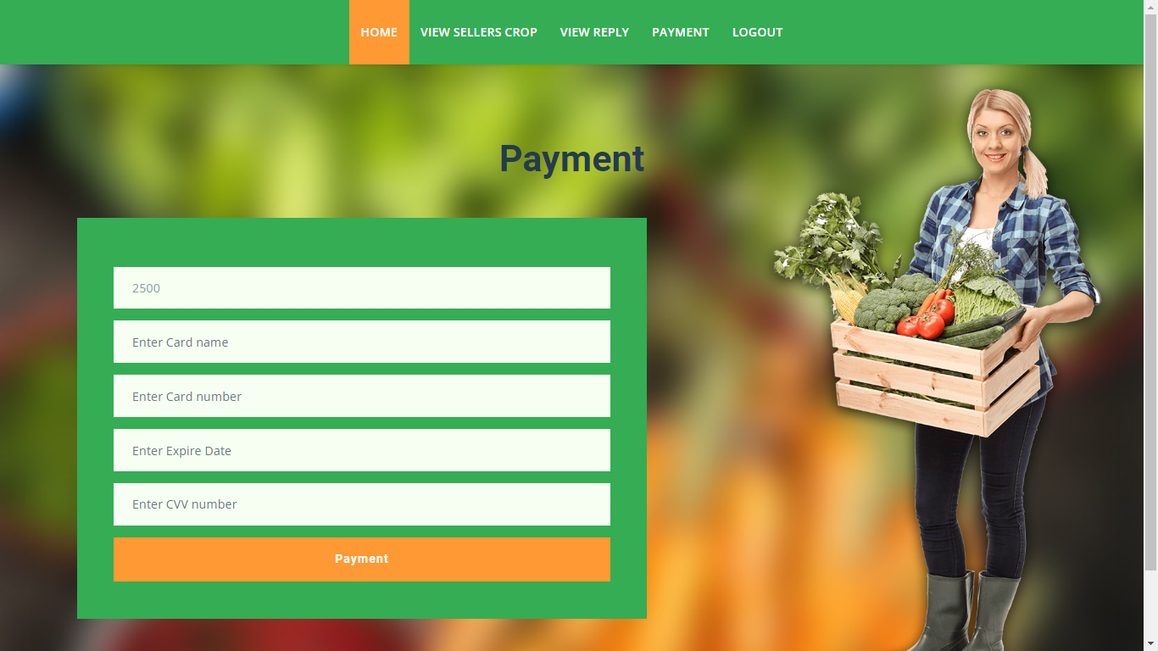
Payment: After scan the QR code Buyer will pay amount, by giving the details like account details.

Slide 63
CONCLUSION
The convergence of decentralized traceability and direct marketing is a transformative force in agriculture supply chains. It promotes transparency and trust while empowering farmers through direct consumer connections, reducing reliance on middlemen and increasing profitability. For consumers, this means heightened confidence in food safety and quality through traceability. Additionally, the streamlined supply chains contribute to environmental sustainability by minimizing food miles. This holistic approach aligns economic interests with environmental responsibility, making it a pivotal advancement in agriculture that benefits all stakeholders.

Slide 64
FUTURE ENHANCEMENT
The scope of this decentralized agriculture supply chain traceability and direct marketing system encompasses the development of a user-friendly platform for buyers, sellers, and an admin. Buyers can register, login, browse seller's crop listings, send purchase requests, view seller responses, make payments, and logout. Sellers can register, login, list their crops with detailed information, view buyer requests, and track payments before logging out. The admin's role is to manage crop prices. The system aims to streamline the agricultural supply chain, foster transparency, and facilitate efficient direct marketing interactions between buyers and sellers.

Slide 65
REFERENCES
[1] Shivendra, Chiranjeevi, Tipathi, M.K & Maktedar, “Blockchain Technology in Agriculture Product Supply Chain”.
[2] K. Salah N. Nizamuddin R. Jayaraman and M. Omar, "Blockchain-based soyabean traceability in agricultural supply chain" IEEE Access vol. 7 pp. 73295-73305 2019.
[3] “Agricultural marketing and Agri-Business in India”
[4] “e-National Agriculture Market - approaches for generating awareness”

Slide 66
REFERENCES
[5] L. U. Opara and F. Mazaud, ‘‘Food traceability from field to plate,’’ Outlook Agricult., vol. 30, no. 2, pp. 239–247, 2001.
[6] F. Dabbene and P. Gay, ‘‘Food traceability systems: Performance evaluation and optimization,’’ Comput. Electron. Agricult., vol. 75, no. 2, pp. 139–146, 2011.
[7] J. Storoy, M. Thakur, and P. Olsen, ‘‘The TraceFood framework— Principles and guidelines for implementing traceability in food value chain,’’ J. Food Eng., vol. 115, no. 2, pp. 41–48, 2013.
[8] M. A. Khan and K. Salah, ‘‘IoT security: Review, blockchain solutions, and open challenges,’’ Future Gener. Comput. Syst., vol. 82, pp. 395–411, May 2018.
[9] L. Lucas. Financial Times. (2018). From Farm to Plate, Blockchain Dishes Up Simple Food Tracking. Accessed: Jun. 12, 2018. [Online]. Available: https://www.ft.com/content/225d32bc-4dfa-11e8-97e4-13afc22d86d4
[10] A. Bogner, M. Chanson, and A. Meeuw, ‘‘A decentralised sharing app running a smart contract on the Ethereum blockchain,’’ in Proc. 6th Int. Conf. Internet Things, 2016, pp. 177–178.

